Slide 1
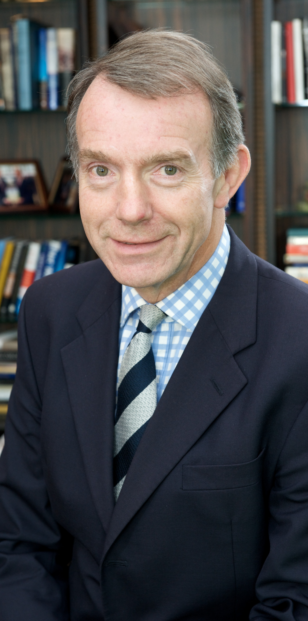
Risk management in high-threat markets
Andrew Farquhar CBE
Managing Director, GardaWorld Consulting (UK) Limited
Andrew Farquhar began military service in 1975, when he joined the an infantry regiment in the British Army. During his 32-year military career he has been all over the world. He has served with Special Forces for a total of 7 years, specialising in counter terrorism with a focus on intelligence and surveillance. His last operational post was as the Deputy Commanding General of the Multi-National Corps in Iraq. He retired as a major general.
He was appointed a Member of the Most Honourable Order of the British Empire (MBE) in 1981 and promoted to Commander (CBE) in 2003. He was appointed an Officer Grade of the United States of America Legion of Merit in 2005 for his work with US Forces. He holds eight other medals or decorations.
Prior to his current post he worked as a consultant advising clients on intelligence, strategy and communication. He was engaged as a crisis negotiator working with the insurance industry and Government agencies.
He is now the Managing Director of GardaWorld Consulting (UK) Limited, the UK element of a large security company that operates in most of the complex environments around the World. His focus is compliance, client management and business development.
He is the Chair of the SCEG.
A graduate of Sheffield University, the Royal Military Academy Sandhurst, the Army Staff College and an alumnus of both Manchester University and London Business Schools.
When possible he enjoys running marathons slowly and offshore sailing.
Securing your reputation across the World
© 2013 GardaWorld Confidential and proprietary 2013

