Slide 1
UK-EU Trade and Cooperation Agreement
3 March 2021

Slide 2
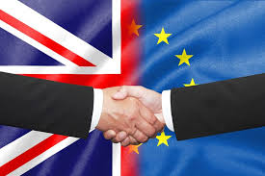
How it all came together
Negotiations intensified in October, both sides worked flat out to come to an agreement.
Overcame significant political barriers on state aid & level playing field, fisheries, and governance.
UK Prime Minister, Boris Johnson, and President of the European Commission, Ursula von der Leyen, engaged frequently in the final days and hours.
Deal finalised on Christmas Eve, full legal text published days later.

Slide 3



What the agreement says (1/3)
Trade in Goods:
  Zero tariffs, zero quotas for qualifying goods.
  Goods must meet rules on local content. Aerospace products unaffected due to WTO plurilateral agreement.
Customs and Trade Facilitation:
  Mutual recognition of trusted trader schemes (AEO).
  Does not remove the need for customs declarations or other administrative processes.
  Does allow for the use of simplifications to forms.
Aviation safety :
  Framework for cooperation & process for agreeing annexes.
  Airworthiness annex sets out recognition of products and designs.

Slide 4


What the agreement says (2/3)
Aviation services:
  No limits on UK and EU carriers providing passenger and cargo services between UK & EU.
  UK airlines no longer able to carry out services between two points in EU. This doesn’t apply to EU subsidiaries.
Chemicals:
  Chemicals annex included, does not give UK access to EU REACH database.
  Companies will need to negotiate access to that data with commercial partners in order to register on UK REACH.
Data adequacy:
  Separate to the agreement, EU assessment ongoing.
  Bridging mechanism of up to six months provides continuity of the free flow of personal data between the UK & EU.

Slide 5



What the agreement says (3/3)
Security:
  New framework for law enforcement and judicial cooperation in criminal and civil law matters.
  Foreign policy, external security and defence cooperation not covered.
  Security of Information Agreement was signed, enabling the voluntary sharing of classified information
EU Programmes and R&D:
  UK will associate with Horizon Europe, Copernicus and the EU’s Satellite Surveillance and Tracking Services.
  UK will have to pay into the schemes.
  No agreement in relation to European Defence Agency and European Defence Fund.
Mobility:
  Covers provisions for temporary entry for specific work purposes.
  Short-term business trips limited to 90 days in any 180-day period.
  Mechanism to agree mutual recognition of professional qualifications in the future.

Slide 6
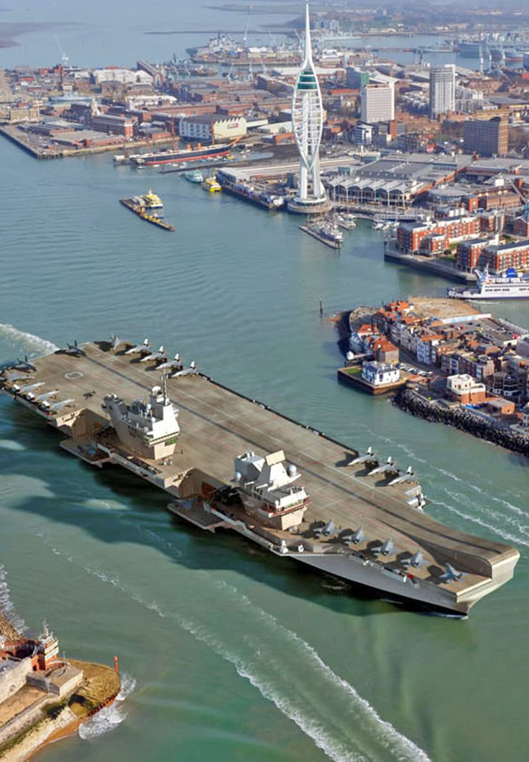
A word on Defence & Security
No agreement on a comprehensive defence and security partnership brings industrial challenges:
  European Defence Fund
  PESCO
  R&D
Future arrangements for UK-EU defence and security industrial cooperation
Continued access to each other’s public procurement markets

Slide 7

Public procurement in post-Brexit UK
Legislation was in place before an agreement was reached in order to provide certainty for ongoing procurements
Any changes to UK procurement regulations will not affect ongoing procurement commenced before the end of the transition period
Entities are to publish notices on the new UK e-notification service called Find a Tender (FTS) instead of in the OJEU
As procurement thresholds are set under the WTO agreement on Government Procurement, they remain the same
Under the TCA, both the UK and EU committed to offering increased access to each other’s procurement markets

Slide 8

Workforce mobility UK to EU
Entry requirements vary by EU Member State
If you are travelling for less than 90 days in a 180-day period, you will not always need a visa
Visa or work permits are now required if you undertake activity not covered by the country visa-waiver
Carrying out a service to a client in another country in which your employer has no presence will require a visa
Customs declaration will be required if you are taking commercial goods out of the UK in your accompanied baggage or vehicle

Slide 9

Workforce mobility EU to UK
The same allowances for EU to UK mobility are in place
Short term business visits will be limited to 90 days in any 180-day period
The agreement, for now, does not include mutual recognition of professional qualifications
The UK has protected the rights of EU citizens in already in the UK before the end of the transition period who should apply for Settled Status by 30 June 2021

Slide 10
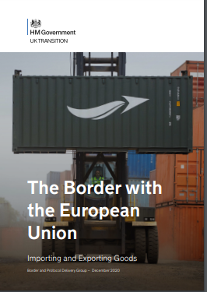
Impacts on Businesses – Brexit and the border
The arrangements for UK border are set out in the Border Operating Model
There are a number of actions UK businesses should be taking to ensure that they can continue to trade goods with the EU, this includes:
Getting an EORI number (starting with GB)
Consider a customs intermediary to help make declarations
Check on the license requirements for your goods
Understand your VAT responsibilities
Consider making use of deferred declarations
Use the Trade Support Service (TSS)
It is important to note the agreement does not impact these requirements

Slide 11
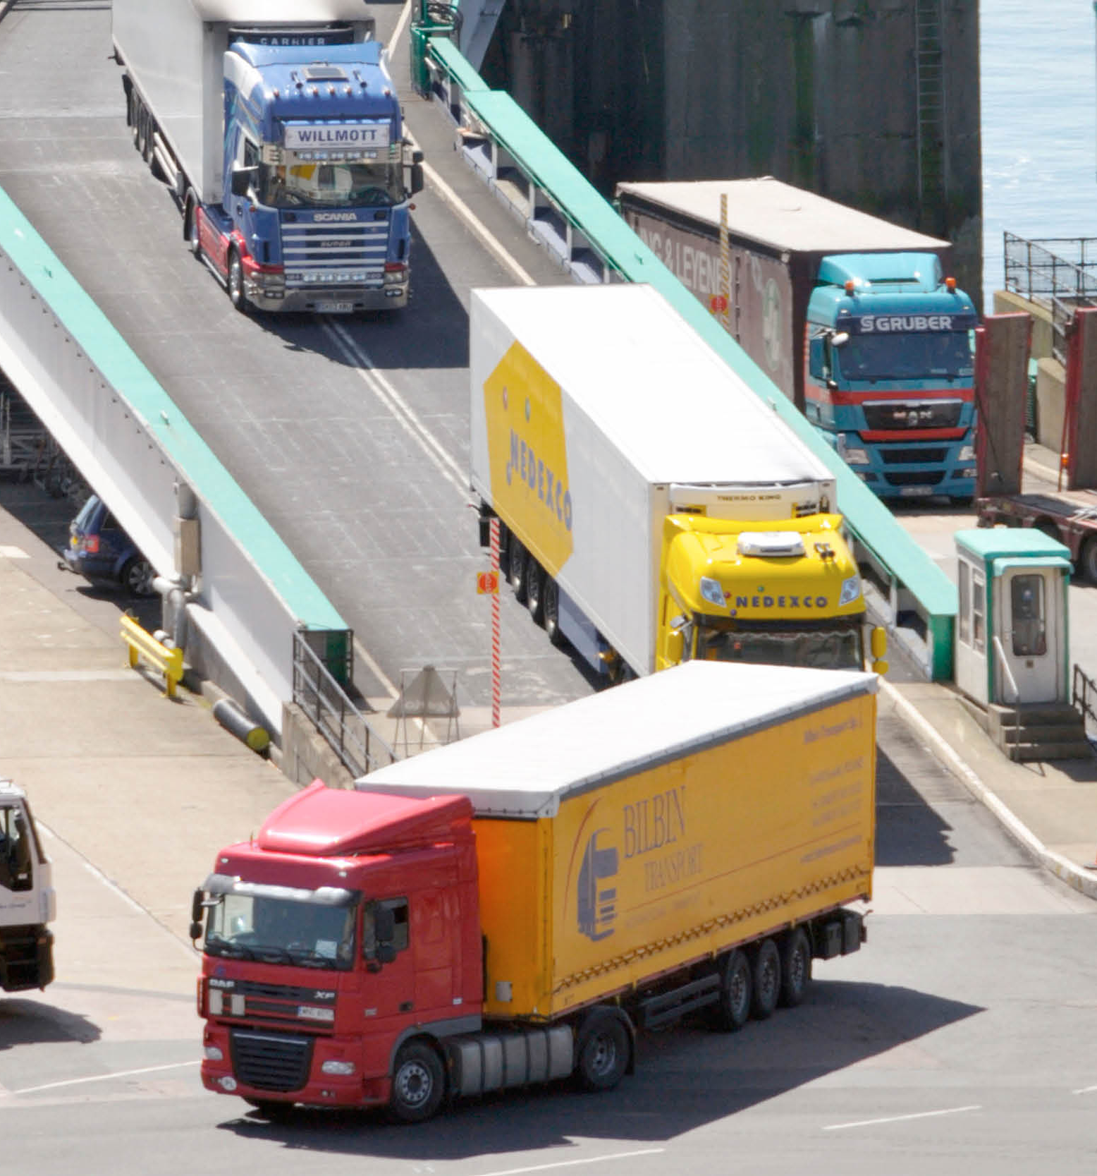
Implementation and current issues at the border
December 2020 saw significant increase in many categories of goods.
First few weeks of 2021 have seen lower than expected volumes of traffic
Empty trucks making up a larger the ‘typical’ amount of movements
No major disruptions at UK ports and new systems working as intended
Government current focus on ensuring hauliers heading to ports secure a negative COVID test

Slide 12

Future UK Trade Agreements Update
US are waiting appointment of Trade Representative, prior to this negotiations were on fifth round
Australia fourth round of negotiations taking place through to March 2021
New Zealand FTA negotiations making progress with third round concluding in February 2021
US, Australia and New Zealand are a priority FTAs to be negotiated.
CPTPP will be managed after that alongside reopening of Mexico and Canada agreements
UK has formally request to commence accession negotiations to CPTPP

Slide 13
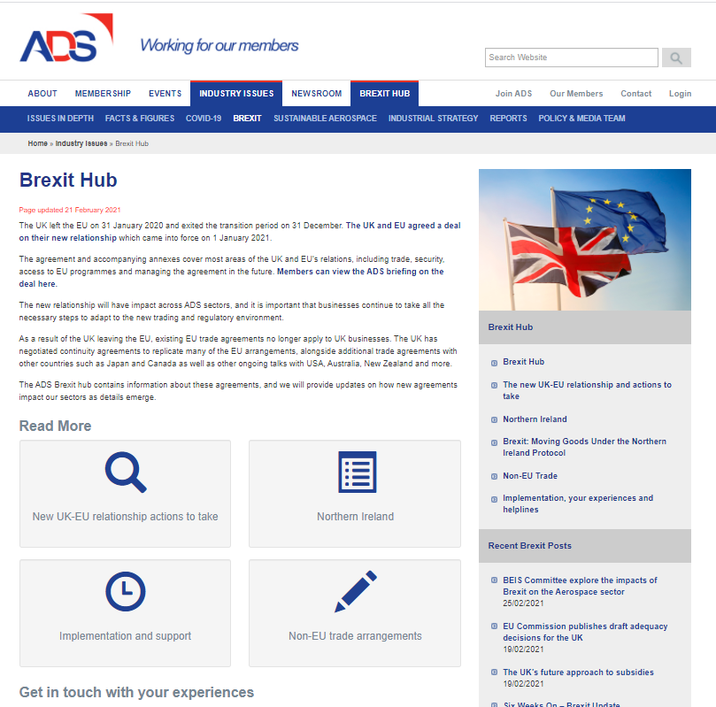
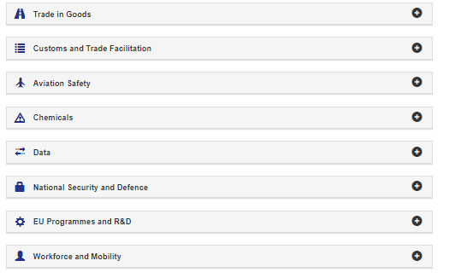
Further information: www.adsgroup.org.uk/brexit
Understand what elements of the TCA may impact upon you business and any new requirements

Slide 14
Questions?

